Slide 1
Survival Analysis Recovery Data
Wanlu Shi

Slide 2
Analysis Scheme
Impaired mobility at admission
Impaired mobility
Braden activity subscale score <3
at admission and during hospitalization
Incident mobility recovery
Braden activity subscale score <3 at admission
≥3 during the hospitalization
VS.
Event: Post-hospitalization mortality
Time: Survival time
If recovery group has lower mortality rate -- The scale works!
METHODS: Kaplan-Meier curves, log-rank tests, and RMST.
Notes:
Post-hospital outcomes were evaluated descriptively and using time to event analyses. Kaplan-Meier curves and log-rank tests were also used to compare the survival probability for mobility impairment and recovery groups. While Cox proportional hazard regression is appropriate for these data, we found that the proportionality assumption was tenuous. As an alternative, logistic regression was used to model the probability of impairment/recovery outcomes. Additionally, an estimate of survival time that is robust to the proportionality assumption was derived according to Royston et al and Zhao et al. This approach reports the difference between two survival curves using the restricted mean— a measure of average survival using the area under the survival curve from time point zero to last observed follow-up time. All models were adjusted for age, gender, race and length of stay. Analyses were conducted in R 3.1.1. All statistical analyses were 2-tailed, and alpha level of 0.05 was considered statistically significant.

Slide 3
Data Analysis
9052 observations, 8 variables
Death is the event indicator, 1 for dead, 0 for alive
Month variable is the month after discharge, if death=1, month means the month dead after discharge. If death=0 , it means the last contact month after discharge.
The treatment variable is recover_or_not in the recovery data.
All other variables are covariates for adjustment (LOS , Admit Age, Sex, Race)
Notes:
there is the description for the data

Slide 4
Data Analysis
Log rank test: a score test for the null hypothesis that two groups have the same failure time distribution.
recover<-read.csv("recover_final2.csv")
recover$Sex<-ifelse(recover$Sex=="FEMALE",1,0) levels(recover$Race)<-1:11 recover<-recover[!is.na(recover$month),]
##log-rank test
survdiff(Surv(month,death)~Recover_or_not,data=recover,rho=0)
Notes:
log-rank test is the same test as the “score test” from the Cox proportional hazard model.
survdiff : compare survival curve between two groups.
Remove the observation if the month value is missing.

Slide 5
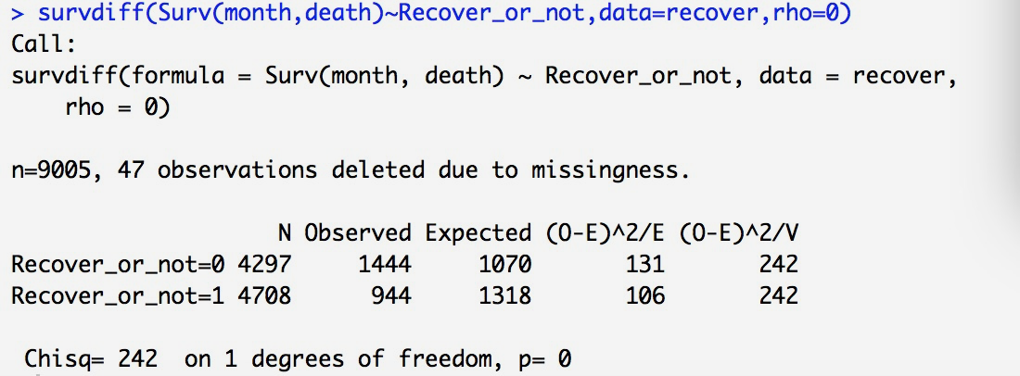
Log-rank Test Result
Notes:
The chi-square test statistic is 242, with p value=0, so we reject the null hypothesis that two groups have the same failure time distribution.

Slide 6
Kaplan-Meier Survival Curve
R code:
KM<-survfit(Surv(month,death)~Recover_or_not,data=recover) plot(KM,lty=c("solid","dashed"),xlab="Month dead after discharge",ylab="Survival Probability") legend("topright",lty=c("solid","dashed"),legend=c("not","Recover",))

Slide 7
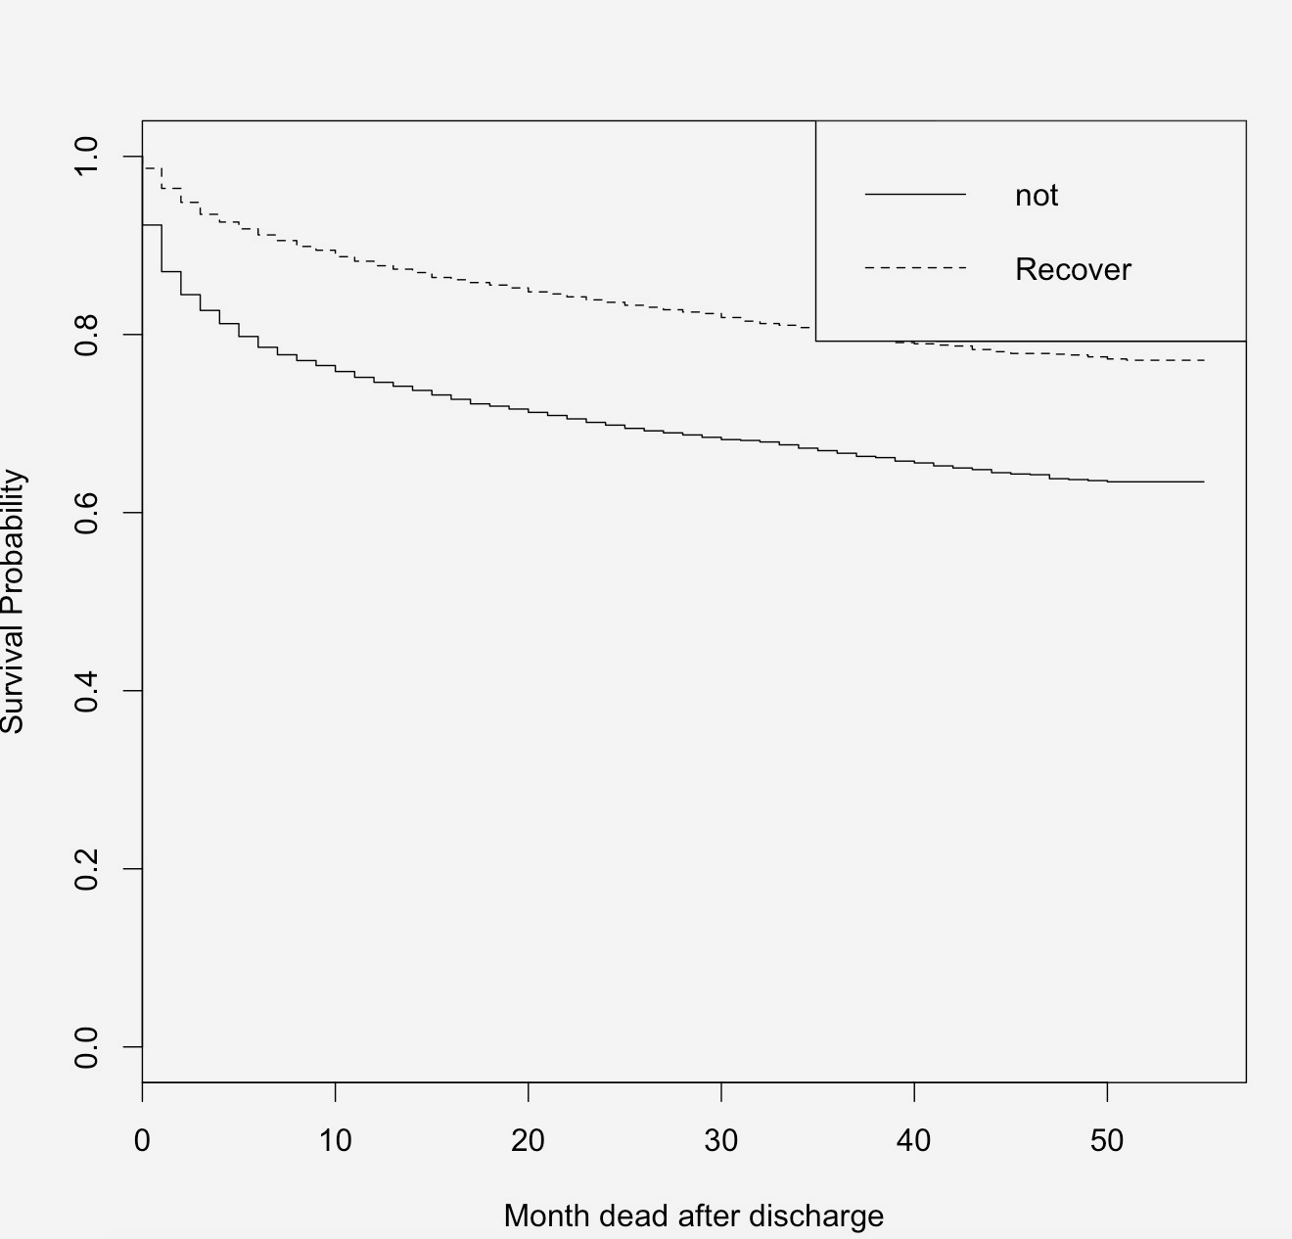
Kaplan-Meier Survival Curve Result
Notes:
Using KM to see the group effect

Slide 8
Cox Model
Use the function cox.zph (Test the proportional hazards assumption for a Cox regression model fit (coxph))
R code
cox.recover<-coxph(Surv(month,death)~LOS+Admit_Age+Sex+Race+Recover_or_not,data=recover) ph<-cox.zph(cox.recover) plot(ph,var="Recover_or_not") ph

Slide 9
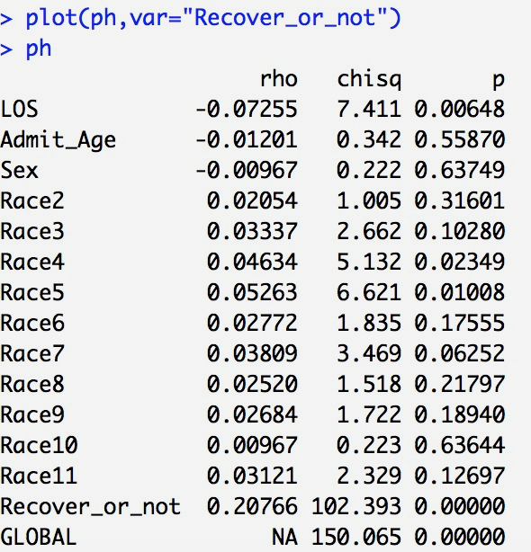
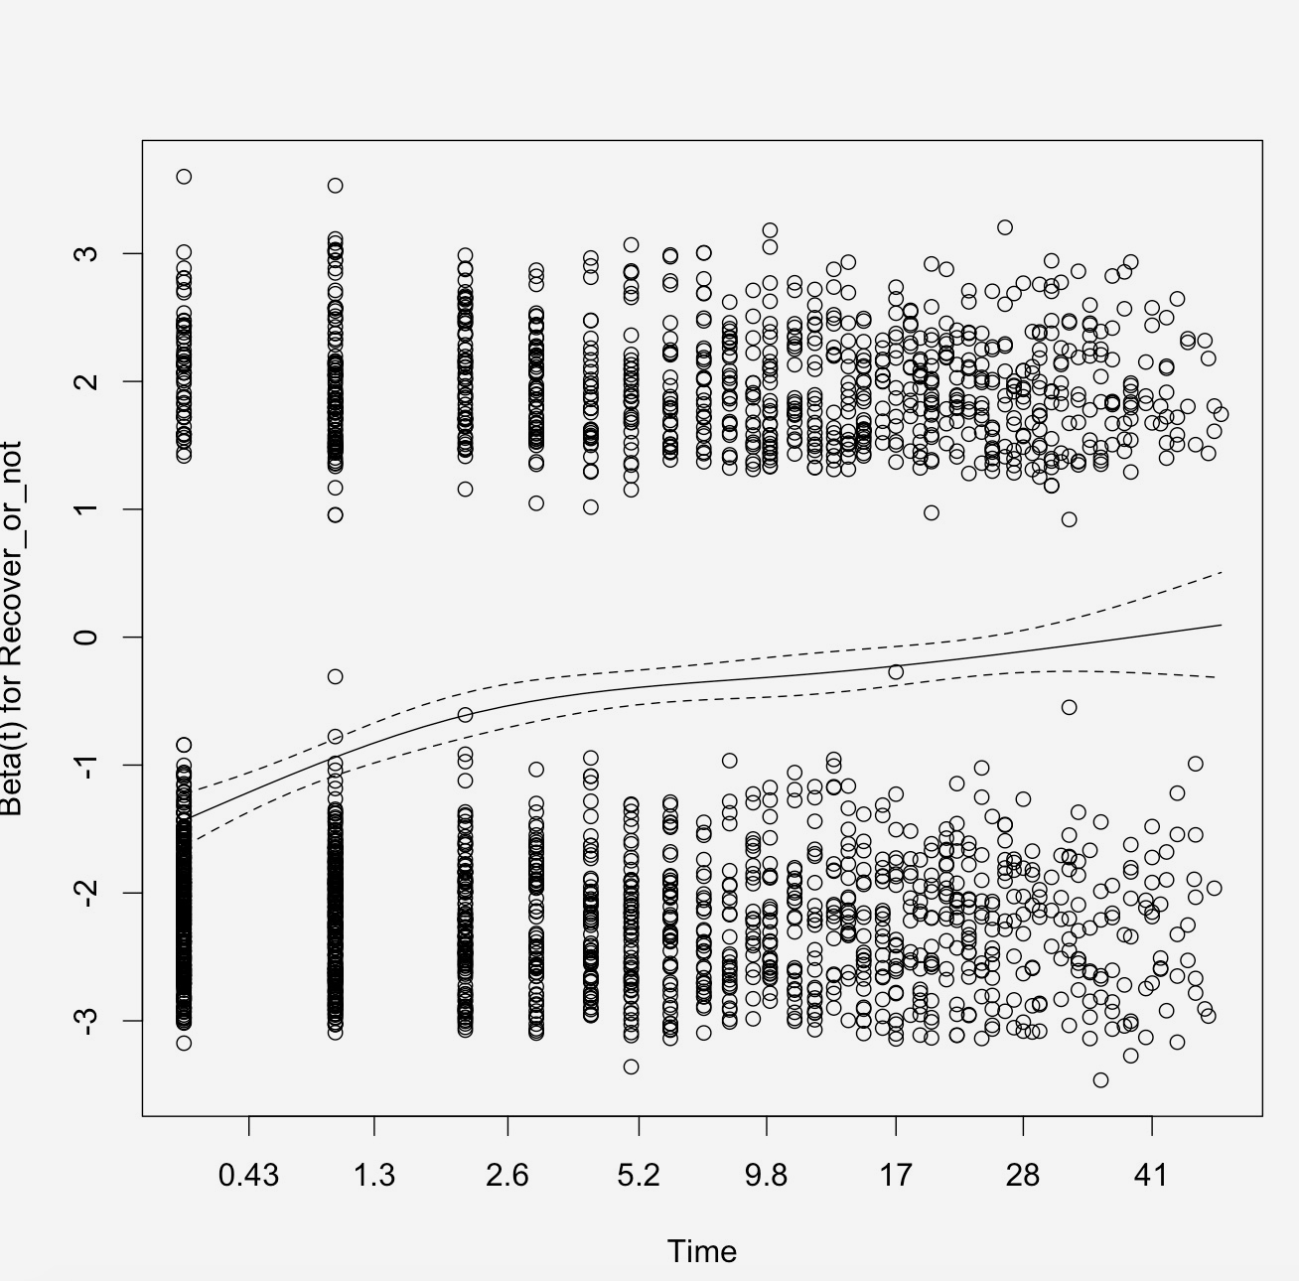
Result
Notes:
From the p value, we reject the null, and we can say that it is violated the proportional hazard. Also, we can see from the residual plot, it is not zero slope.

